Slide 1
Topic 6: Agile Modeling and Prototyping (Chapter 6)
Kendall & Kendall Systems Analysis and Design, Global Edition, 9e

Slide 2
Learning Objectives
Understand the roots of agile modeling in prototyping and the four main types of prototyping.
Be able to use prototyping for human information requirements gathering.
Understand agile modeling and the core practices that differentiate it from other development methodologies.
Learn the importance of values critical to agile modeling.
Understand how to improve efficiency for users who are knowledge workers using either structured methods or agile modeling.

Slide 3
Agile Modeling, but First Prototyping
Agile modeling is a collection of innovative, user-centered approaches to system development
Prototyping is an information-gathering technique useful in seeking
User reactions
Suggestions
Innovations
Revision plans
Notes:
Prototyping and RAD (rapid application development) can also be used as an alternative method to SDLC.

Slide 4
Major Topics
Prototyping
Agile modeling

Slide 5
Major Topics
Prototyping
Agile modeling

Slide 6
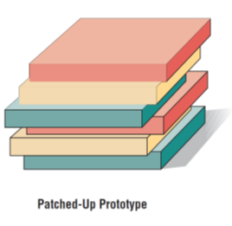
Prototyping
Patched-Up Prototype
A system that works but is patched up or patched together
A working model that has all the features but is inefficient where users can interact with the system, but the retrieval and storage of information may be inefficient
Patched-up
Nonoperational
First-of-a-series
Selected features
Notes:
Information gathered in the prototyping phase allows the analyst to set priorities and redirect plans inexpensively, with a minimum of disruption.

Slide 7
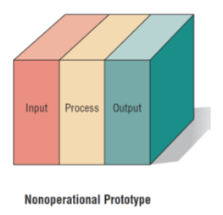
Prototyping
Nonoperational Scale Models
A nonworking scale mode that is set up to test certain aspects of the design
A nonworking scale model of an information system might be produced when the coding required by the application is too expensive to prototype but when a useful idea of the system can be gained through prototyping of the input and output only.
Patched-up
Nonoperational
First-of-a-series
Selected features
Notes:
Information gathered in the prototyping phase allows the analyst to set priorities and redirect plans inexpensively, with a minimum of disruption.

Slide 8
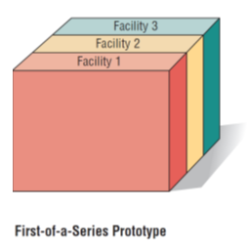
Prototyping
First-of-a-Series Prototype
Creating a first fullscale model of a system, often called a pilot
Prototype is completely operational
Useful when many installations of the same information system are planned
A full-scale prototype is installed in one or two locations first, and if successful, duplicates are installed at all locations based on customer usage patterns and other key factors
Patched-up
Nonoperational
First-of-a-series
Selected features
Notes:
Information gathered in the prototyping phase allows the analyst to set priorities and redirect plans inexpensively, with a minimum of disruption.

Slide 9
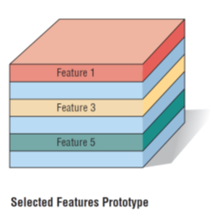
Prototyping
Selected Features Prototype
Building an operational model that includes some, but not all, of the features that the final system will have
Some, but not all, essential features are included
Built in modules
Part of the actual system
Patched-up
Nonoperational
First-of-a-series
Selected features
Notes:
Information gathered in the prototyping phase allows the analyst to set priorities and redirect plans inexpensively, with a minimum of disruption.

Slide 10
Prototyping as an Alternative to the Systems Life Cycle
Drawbacks to Supplanting the SDLC With Prototyping
Drawbacks include prematurely shaping a system before the problem or opportunity is thoroughly understood
Using prototyping as an alternative may result in producing a system that is accepted by specific groups of users but is inadequate for overall system needs
Two main problems with the SDLC
Extended time required to go through the development life cycle
User requirements change over time
Rather than using prototyping to replace the SDLC use prototyping as a part of the SDLC
Notes:
SDLC—a logical, systematic approach to follow in the development of information systems.
Rather than using prototyping to replace the SDLC use prototyping as a part of the SDLC.
Advantages:
effectively shortens the time between ascertainment of human information requirements and delivery of a workable system.
overcomes some of the problems of accurately identifying user information requirements.
Disadvantages:
prematurely shaping a system before the problem or opportunity being addressed is thoroughly understood.
may result in producing a system that is accepted by specific groups of users but that is inadequate for overall system needs.

Slide 11
Guidelines for Developing a Prototype
Work in manageable modules
Build the prototype rapidly
Modify the prototype in successive iterations
Stress the user interface
Work in Manageable Modules
It is imperative that an analyst work in manageable modules
One distinct advantage of prototyping is that it is not necessary or desirable to build an entire working system for prototype purposes
A manageable module allows users to interact with its key features but can be built separately from other system modules
Module features that are deemed less important are purposely left out of the initial prototype
Notes:
Prototyping is a superb way to elicit feedback about the proposed system and about how readily it is fulfilling the information needs of its users.
The first step of prototyping is to estimate the costs involved in building a module of the system.
Work in manageable modules—a manageable module is one that allows users to interact with its key features but can be built separately from other system modules.
Build the prototype rapidly—putting together an operational prototype both rapidly and early in the SDLC allows the analyst to gain valuable insight into how the remainder of the project should go.
Modify the prototype—creating it in modules that are not highly interdependent.
Stress the user interface—for many users the interface is the system.

Slide 12
Guidelines for Developing a Prototype
Work in manageable modules
Build the prototype rapidly
Modify the prototype in successive iterations
Stress the user interface
Build the Prototype Rapidly
Speed is essential for successful prototyping
Analysts can use prototyping to shorten this gap by using traditional information-gathering techniques to find information requirements
Make decisions that bring forth a working model
Putting together an operational prototype rapidly and early in the SDLC allows an analyst to gain insight about the remainder of the project
Showing users early in the process how parts of the system actually perform guards against overcommitting resources to a project that may eventually become unworkable
Notes:
Prototyping is a superb way to elicit feedback about the proposed system and about how readily it is fulfilling the information needs of its users.
The first step of prototyping is to estimate the costs involved in building a module of the system.
Work in manageable modules—a manageable module is one that allows users to interact with its key features but can be built separately from other system modules.
Build the prototype rapidly—putting together an operational prototype both rapidly and early in the SDLC allows the analyst to gain valuable insight into how the remainder of the project should go.
Modify the prototype—creating it in modules that are not highly interdependent.
Stress the user interface—for many users the interface is the system.

Slide 13
Guidelines for Developing a Prototype
Work in manageable modules
Build the prototype rapidly
Modify the prototype in successive iterations
Stress the user interface
Modify the Prototype in successive iterations
Making a prototype modifiable means creating it in modules that are not highly interdependent
The prototype is usually modified several times
Changes should move the system closer to what users say is important
Each modification is followed by an evaluation by users
Notes:
Prototyping is a superb way to elicit feedback about the proposed system and about how readily it is fulfilling the information needs of its users.
The first step of prototyping is to estimate the costs involved in building a module of the system.
Work in manageable modules—a manageable module is one that allows users to interact with its key features but can be built separately from other system modules.
Build the prototype rapidly—putting together an operational prototype both rapidly and early in the SDLC allows the analyst to gain valuable insight into how the remainder of the project should go.
Modify the prototype—creating it in modules that are not highly interdependent.
Stress the user interface—for many users the interface is the system.

Slide 14
Guidelines for Developing a Prototype
Work in manageable modules
Build the prototype rapidly
Modify the prototype in successive iterations
Stress the user interface
Stress the User Interface
Use the prototype is to get users to further articulate their information requirements
They should be able to see how the prototype will enable them to accomplish their tasks
The user interface must be well developed enough to enable users to pick up the system quickly
Online, interactive systems using GUI interfaces are ideally suited to prototypes
Notes:
Prototyping is a superb way to elicit feedback about the proposed system and about how readily it is fulfilling the information needs of its users.
The first step of prototyping is to estimate the costs involved in building a module of the system.
Work in manageable modules—a manageable module is one that allows users to interact with its key features but can be built separately from other system modules.
Build the prototype rapidly—putting together an operational prototype both rapidly and early in the SDLC allows the analyst to gain valuable insight into how the remainder of the project should go.
Modify the prototype—creating it in modules that are not highly interdependent.
Stress the user interface—for many users the interface is the system.

Slide 15

Prototyping Using Commercial-Off-The-Shelf (COTS) Software
Sometimes the quickest way to prototype is through the modular installation of COTS software
Some COTS software is elaborate and expensive, but highly useful, for example the PeopleSoft software.
Notes:
Example: Catholic University’s use of the ERP COTS software package called PeopleSoft, which is handling many of its web-based functions.

Slide 16
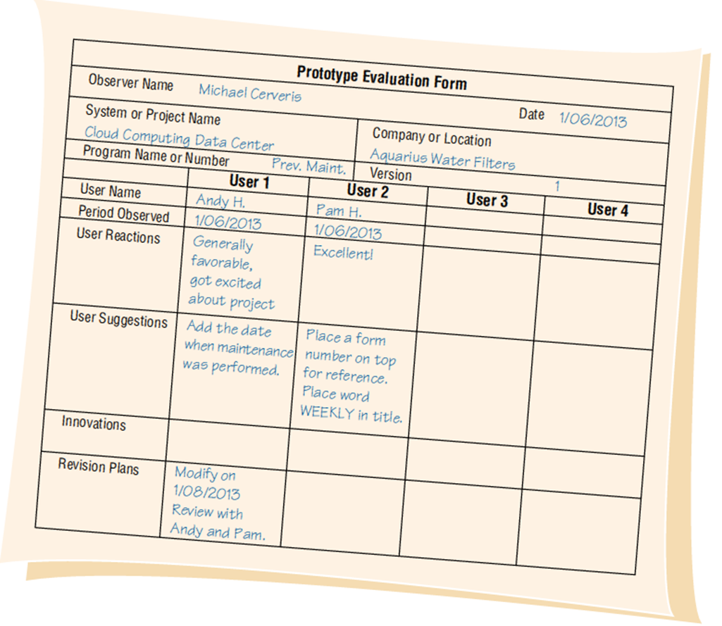
Users’ Role in Prototyping
Honest involvement
Experimenting with the prototype
Giving open reactions to the prototype
Suggesting additions to or deletions from the prototype
Prototype Evaluation Form
Notes:
Without user involvement there is little reason to prototype.
To facilitate the prototyping process, the analyst must clearly communicate the purposes of prototyping to users, along with the idea that prototyping is valuable only when users are meaningfully involved.

Slide 17
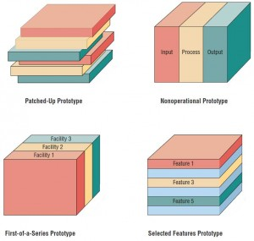

Slide 18
Major Topics
Prototyping
Agile modeling

Slide 19
Agile Modeling
Agile methods are a collection of innovative, user-centered approaches to systems development

Slide 20
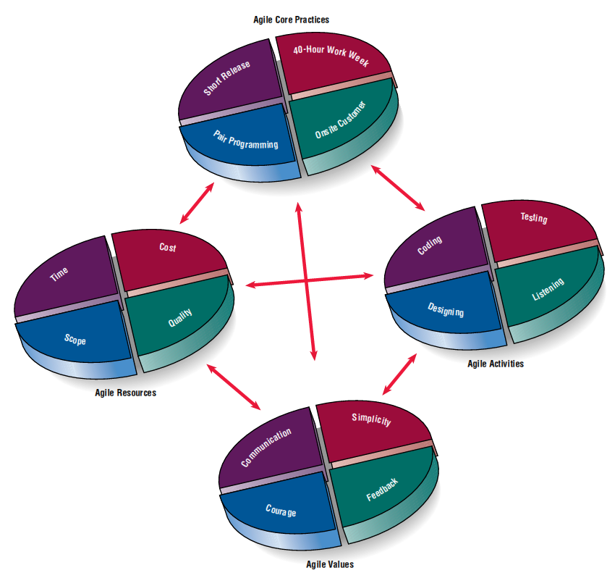
Agile core practices are interrelated
with agile modeling’s resources,
activities, and values.

Slide 21
Agile core practices are interrelated
with agile modeling’s resources,
activities, and values.

Slide 22
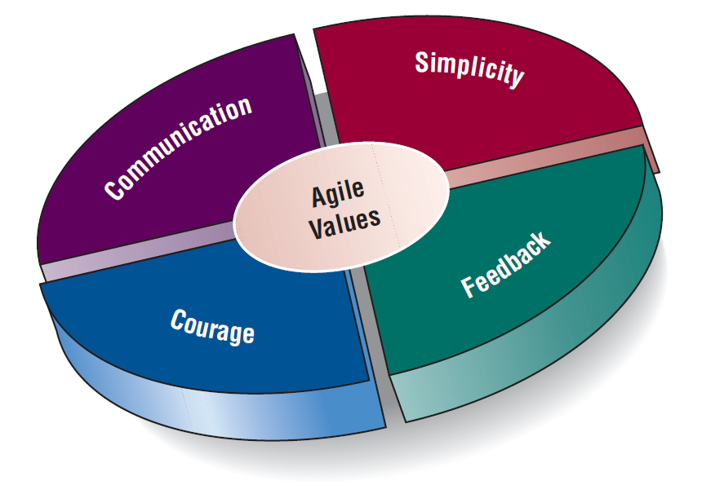
Values and Principles of Agile Modeling
Communication
Simplicity
Feedback
Courage
Notes:
Agile modelers possess the self-confidence to allow their customers to question, critique, and sometimes complain about the system under development. Analysts learn from their customers, who have been in business a long time.

Slide 23
Values Are Crucial to the Agile Approach (Figure 6.4)
The agile value of simplicity asks us to do the simplest thing today, with the understanding that it might have to be changed a little tomorrow. This requires a clear focus on the goals of the project and really is a basic value.
Typical agile practices such as pair programming (two programmers collaborating, described later in the chapter), estimating tasks, and unit testing rely heavily on good communication.
Feedback is the third basic value that is important when taking an extreme programming approach. When you think of feedback in this context, it is good to consider that feedback is wrapped up with the concept of time. Good, concrete feedback that is useful to the programmer, analyst, and customer can occur within seconds, minutes, days, weeks, or months, depending on what is needed, who is communicating, and what will be done with the feedback.
The value of courage has to do with a level of trust and comfort that must exist in the development team. It means not being afraid to throw out an afternoon or a day of programming and begin again if all is not right. It means being able to stay in touch with one’s instincts (and test results) concerning what is working and what is not.

Slide 24
The Basic Principles of Agile Modeling
Satisfy the customer through delivery of working software
Embrace change, even if introduced late in development
Continue to deliver functioning software incrementally and frequently
Encourage customers and analysts to work together daily
Trust motivated individuals to get the job done
Promote face-to-face conversation
Concentrate on getting software to work
Encourage continuous, regular, and sustainable development
Adopt agility with attention to mindful design
Support self-organizing teams
Provide rapid feedback
Encourage quality
Review and adjust behavior occasionally
Adopt simplicity
Notes:
Providing rapid feedback—in order for humans or the system to make a connection between a stimulus and reaction, the feedback must occur at a reasonable interval.
Assuming simplicity—over 90 percent of problems can be solved with utter simplicity.
Changing incrementally—you are constantly making the smallest change possible that still results in a difference in the development effort.
Embracing change—we want to keep all of our options open, but we want to be able to simultaneously solve whatever presents the biggest obstacle.
Encouraging quality work—all participants want to do quality work.

Slide 25
Agile core practices are interrelated
with agile modeling’s resources,
activities, and values.

Slide 26
Four Basic Activities of Agile Modeling
Coding
Coding is the one activity that it is not possible to do without
The most valuable thing that we receive from code is “learning”
Code can also be used to communicate ideas that would otherwise remain fuzzy or unshaped
Coding
Testing
Listening
Designing
Notes:
The agile analyst needs to identify the amount of effort that will go into each activity and balance that with the resources needed to complete the project.
Coding—the most valuable thing that we receive from code is “learning.”
Testing—the agile approach views automated tests as critical.
Listening—in the agile approach, listening is done in the extreme.
Designing—a way of creating a structure to organize all of the logic in the system.

Slide 27
Four Basic Activities of Agile Modeling
Testing
Automated testing is critical
Write tests to check coding, functionality, performance, and conformance
Use automated tests
Large libraries of tests exist for most programming languages
These are updated as necessary during the project
Testing in the short term gives extreme confidence in what you are building
Testing in the long term keeps a system alive and allows for changes longer than would be possible if no tests were written or run
Coding
Testing
Listening
Designing
Notes:
The agile analyst needs to identify the amount of effort that will go into each activity and balance that with the resources needed to complete the project.
Coding—the most valuable thing that we receive from code is “learning.”
Testing—the agile approach views automated tests as critical.
Listening—in the agile approach, listening is done in the extreme.
Designing—a way of creating a structure to organize all of the logic in the system.

Slide 28
Four Basic Activities of Agile Modeling
Listening
Listening is done in the extreme
Developers use active listening to hear their programming partner
Because there is less reliance on formal, written communication, listening becomes a paramount skill
A developer also uses active listening with the customer
Developers assume that they know nothing about the business so they must listen carefully to businesspeople
Coding
Testing
Listening
Designing
Notes:
The agile analyst needs to identify the amount of effort that will go into each activity and balance that with the resources needed to complete the project.
Coding—the most valuable thing that we receive from code is “learning.”
Testing—the agile approach views automated tests as critical.
Listening—in the agile approach, listening is done in the extreme.
Designing—a way of creating a structure to organize all of the logic in the system.

Slide 29
Four Basic Activities of Agile Modeling
Designing
Designing is a way of creating a structure to organize all the logic in the system
Designing is evolutionary, and so systems are conceptualized as evolving, always being designed
Good design is often simple
Design should allow flexibility
Effective design locates logic near the data on which it will be operating
Design should be useful to all those who will need it as the development effort proceeds
Coding
Testing
Listening
Designing
Notes:
The agile analyst needs to identify the amount of effort that will go into each activity and balance that with the resources needed to complete the project.
Coding—the most valuable thing that we receive from code is “learning.”
Testing—the agile approach views automated tests as critical.
Listening—in the agile approach, listening is done in the extreme.
Designing—a way of creating a structure to organize all of the logic in the system.

Slide 30
Agile core practices are interrelated
with agile modeling’s resources,
activities, and values.

Slide 31
Four Resource Control Variables of Agile Modeling
Time - Time, however, is split into many separate pieces. You need time to listen to the customers, time to design, time to code, and time to test.
Cost - Cost is the second variable we can consider adjusting.
Quality - The extreme philosophy of agile development allows some of the external quality issues to be sacrificed. In order for the system to be released on time, the customer may have to contend with some software bugs. If we want to meet our deadline, the user interface may not be perfect. We can make it better in a follow-up version.
Scope - scope is determined by listening to customers and getting them to write down their stories. Then the stories are examined to see how much can be done in a given time to satisfy the customer.
Notes:
When these four control variables are properly included in the planning, there is a state of balance between the resources and the activities needed to complete the project.

Slide 32
Agile core practices are interrelated
with agile modeling’s resources,
activities, and values.

Slide 33
Four Core Agile Practices
Short releases - the development team compresses the time between releases of their product. Using the short release practice, they will shorten the release time by tackling the most important features first, releasing that system or product, and then improving it later.
40-hour work week - agile development teams purposely endorse a cultural core practice in which the team works intensely together during a typical 40-hour workweek.
Onsite customer - a user who is an expert in the business aspect of the systems development work is onsite during the development process.
Pair programming - . It means that you work with another programmer of your own choosing. You both do coding, you both run tests. Working with another programmer helps you clarify your thinking.
Notes:
Short releases—the development team compresses the time between releases of their product.
40-hour work week—agile development teams purposely endorse a cultural core practice in which the team works intensely together during a typical 40-hour work week.
Onsite customer—a user who is an expert in the business aspect of the systems development work is onsite during the development process.
Pair programming—you work with another programmer of your own choosing.

Slide 34
Agile core practices are interrelated
with agile modeling’s resources,
activities, and values.

Slide 35
The Agile Development Process
Listen for user stories
Draw a logical workflow model
Create new user stories based on the logical model
Develop some display prototypes
Create a physical data model using feedback from the prototypes and logical workflow diagrams

Slide 36
Writing User Stories
Spoken interaction between developers and users
Seeking first and foremost to identify valuable business user requirements
The goal is prevention of misunderstandings or misinterpretations of user requirements
Notes:
User stories serve as reminders to the developers that they must hold conversations devoted to those requirements.

Slide 37
User Stories Can Be Recorded on Cards (Figure 6.6)
Notes:
In this example from the online merchant, the analyst indicates that the designing activity will take above-average effort, and the time and quality resources are required to rise above average.

Slide 38

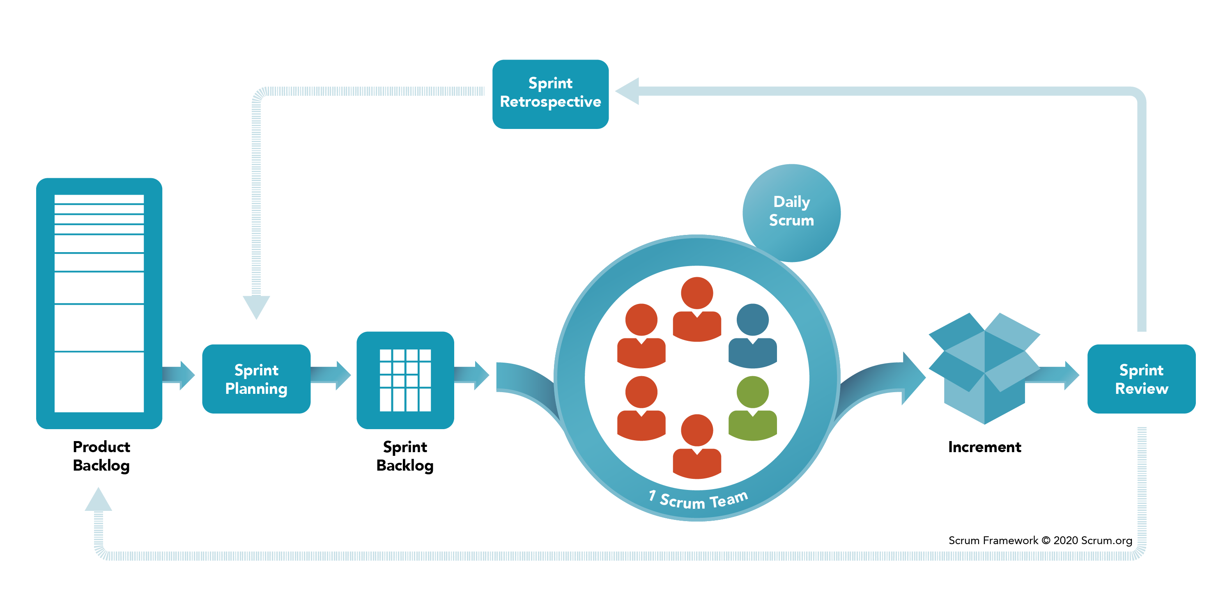
Scrum
Begin the project with a high-level plan that can be changed on the fly
Success of the project is most important
Individual success is secondary
Project leader has some (not much) influence on the detail
Systems team works within a strict time frame
https://www.scrum.org/resources/what-is-scrum

Slide 39
Scrum
Product backlog
Sprint backlog
Sprint
Daily scrum
Demo
https://www.scrum.org/resources/what-is-scrum
Notes:
Scrum is a high-intensity methodology. It is just one of the approaches that adopts the philosophy of agile modeling.
Product backlog—in which a list is derived from product specifications.
Sprint backlog—a dynamically changing list of tasks to be completed in the next sprint.
Sprint—a 30-day period in which the development team transforms the backlog into software that can be demonstrated.
Daily scrum—a brief meeting in which communication is the number-one rule.
Demo—working software that can be demonstrated to the customer.

Slide 40
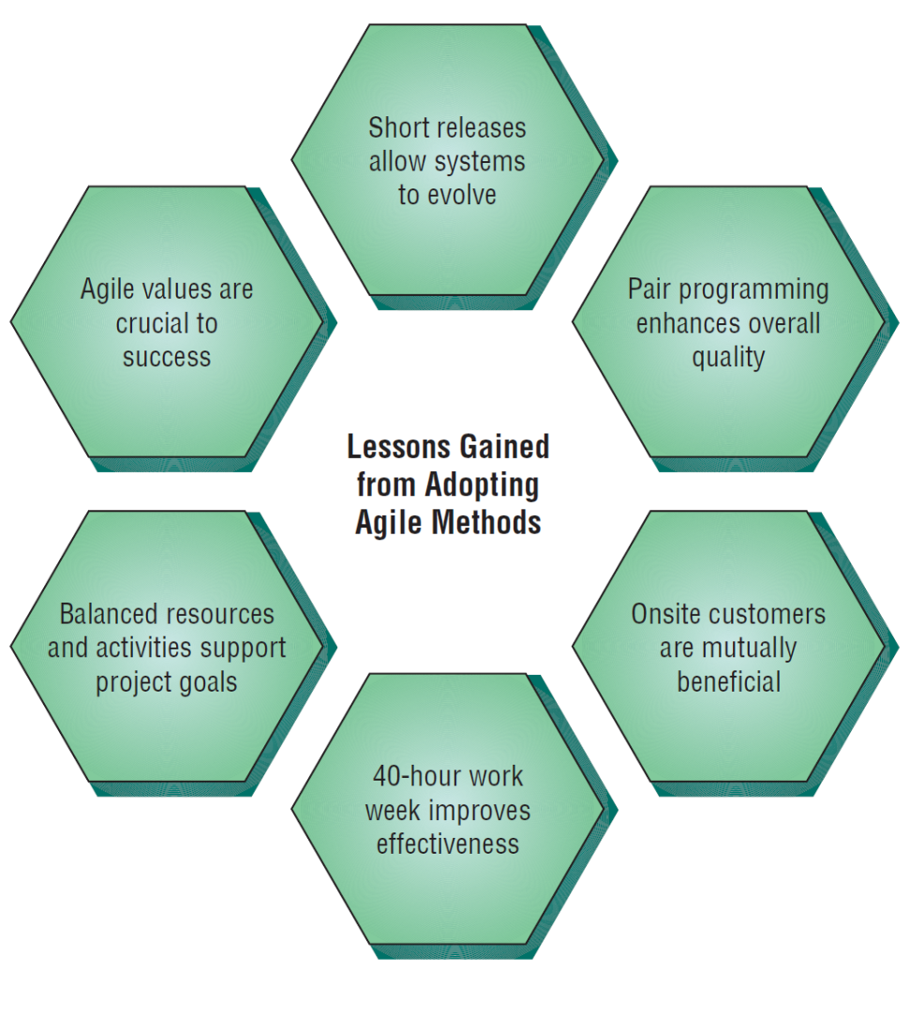
Lessons Learned from Agile Modeling
Short releases allow the system to evolve
Pair programming enhances the overall quality
Onsite customers are mutually beneficial to the business and the agile development team
The 40-hour work week improves worker effectiveness
Balanced resources and activities support project goals
Agile values are crucial to success
There Are Six Vital Lessons That Can Be Drawn from the Agile Approach to Systems
Notes:
Short releases allow the system to evolve—through the use of short releases, the development team compresses the time between releases of their product, improving the product later as the dynamic situation demands.
Pair programming enhances overall quality—fosters good communication, identifying with the customer, focusing on the most valuable aspects of the project first, testing all code as it is developed, and integrating the new code after it successfully passes its tests.
Onsite customers are mutually beneficial to the business and the agile development team—customers serve as a ready reference and reality check, and the focus of the system design will always be maintained via their presence.

Slide 41
Comparing Agile Modeling and Structured Methods
Improving the efficiency of systems development
Risks inherent in organizational innovation
Notes:
Efficiency—seven strategies that can improve the efficiency of knowledge work.
Risks—when is the appropriate time to upgrade human skills, adopt new organizational processes, and institute internal change.

Slide 42
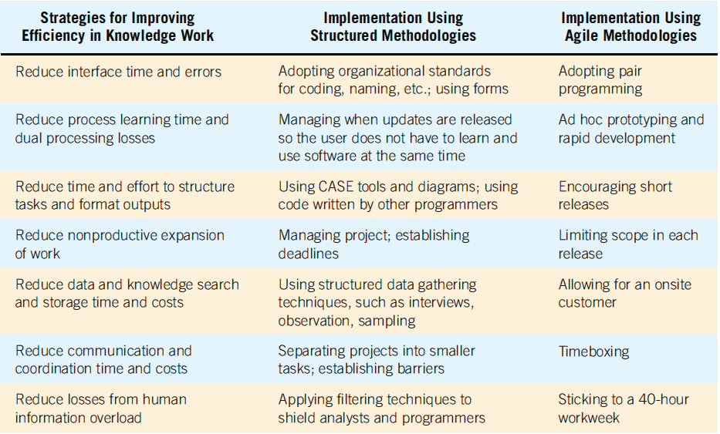
Strategies for Improving Efficiency Can Be Implemented Using Two Different Development Approaches (Figure 6.8)

Slide 43
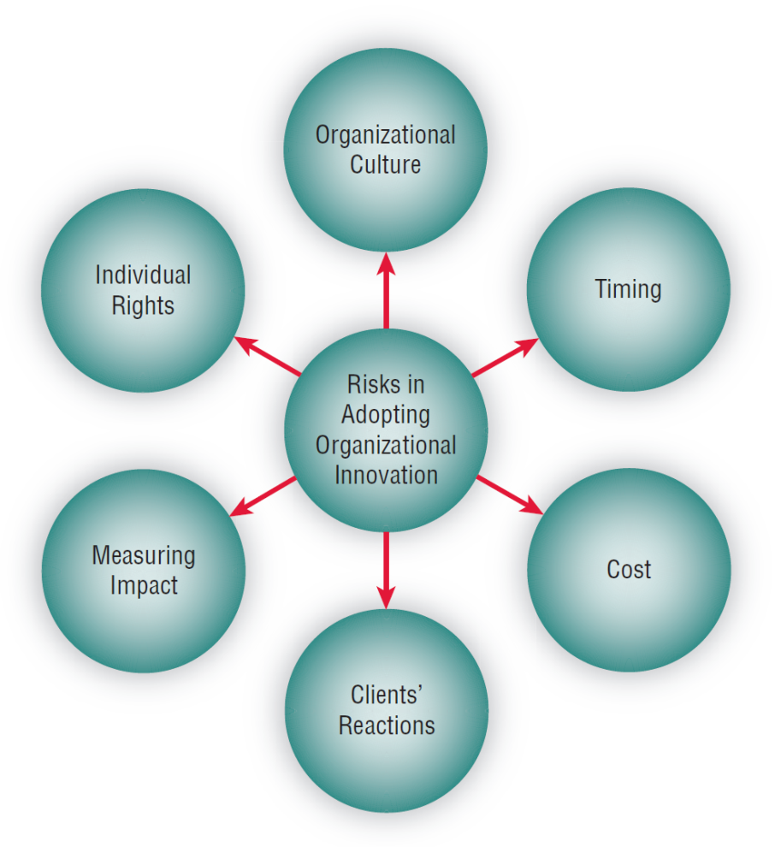
Risks When Adopting New Information Systems
Fit of development team culture
Best time to innovate
Training cost for analysts and programmers
Client’s reaction to new methodology
Impact of agile methodologies
Programmers/analysts individual rights
Adopting New Information Systems Involves Balancing Several Risks

Slide 44
Summary
Prototyping
Patched-up system
Nonoperational
First-of-a-series
Selected-features
Prototype development guidelines
Prototype disadvantages
Prototype advantages
Users’ role in prototyping
Agile modeling
Five values of the agile approach
Principles of agile development
Agile activities
Agile resources
Core practices of the agile approach
Stages in the agile development process
User stories
Agile lessons
Scrum methodology
Dangers to adopting innovative approaches

Slide 45
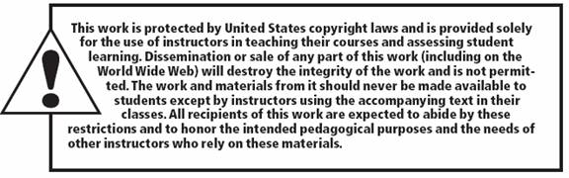
Copyright © 2014 Pearson Education

